Slide 1
Billy-Buddy: An AI-Powered Solution for Cyberbullying, Detection, Prevention and Victim Support
PIP2001 Capstone Project
Final Review
Batch Number: CST-G16
Roll Number | Student Name
20211CST0092 | Mekala Charan Kumar
20211CST0137 | Krithik S
20211CST0031 | Gandu Sanjay
20211CST0014 | Mohammed Kaif
Under the Supervision of,
Dr. Marimuthu K,
Professor,
School of Computer Science and Engineering,
Presidency University.
Name of the Program: B.TECH
Name of the HoD: Dr. Saira Banu Atham
Name of the Program Project Coordinator: Dr. H M Manjula
Name of the School Project Coordinators: Dr. Abdul Khadar A

Slide 2
Introduction
Cyberbullying has become an increasingly serious issue with the rise of social media platforms, online communication tools, and the internet. According to Smith et al. (2008), cyberbullying refers to aggressive, intentional acts carried out repeatedly via electronic forms of contact, targeting victims who cannot easily defend themselves. It affects children, teenagers, and adults, often leading to severe emotional, psychological, and social consequences (Tokunaga, 2010). This section provides a broad overview of the problem to contextualize the development of solutions like "Billy-Buddy."

Slide 3
Literature Review
Deep-Learning-Based Cyberbullying Detection:The paper reviews deep learning-based cyberbullying detection techniques, analyzing existing methods, datasets, and future research challenges.
Predicting Cyberbullying on Social Media in the Big Data Era:The paper reviews cyberbullying prediction models on social media, focusing on feature selection, machine learning algorithms, and key challenges for future research.
Artifcial Intelligence‑Enabled Cyberbullying‑Free Online SocialNetworks in Smart Cities:The paper proposes an AI-enabled technique (AICBF-ONS) for detecting cyberbullying in online social networks using feature selection and classification models optimized with advanced algorithms.
A Review of Machine Learning Techniques in Cyberbullying Detection:The paper provides a systematic review of machine learning and natural language processing methods for detecting cyberbullying, highlighting key stages, challenges, and future research directions.
Artificial Intelligence-Driven Cyberbullying Detection:The paper reviews deep learning techniques for detecting cyberbullying on online platforms, highlighting current advancements and future research opportunities.

Slide 4
Research Gaps Identified
Sl No | Study | Gap
1 | Existing platforms for bullying support focus primarily on providing static resources like articles and tips. | Lack of interactive and personalized support systems, such as chatbots, to engage victims and provide real-time motivation and guidance.
2 | Social media-based support groups help victims connect but often lack privacy and security. | Absence of a dedicated, secure platform that facilitates private communication among victims while protecting their identity and data.
3 | Reporting mechanisms in most bullying support platforms are cumbersome and disconnected from law enforcement agencies. | Inefficient or non-existent processes for directly forwarding bullying complaints to the relevant authorities, such as the police cybersecurity team.
4 | Community support initiatives often fail to foster long-term engagement among victims. | Lack of community-driven platforms that encourage sustained participation and sharing of coping strategies within a secure ecosystem.
5 | Few solutions offer an integrated approach to tackle bullying, combining reporting, support, and community-building. | Need for a comprehensive platform that integrates incident reporting, motivational support, and a collaborative community space.

Slide 5
Proposed Methodology
Problem Identification : Research and understand the impact of cyberbullying, particularly among teenagers. Identify the shortcomings of existing cyberbullying reporting and support mechanisms.
Chatbot Development (Billy):Design and develop a user-friendly, AI-powered chatbot (“Billy”) that offers real-time emotional support. Integrate Natural Language Processing (NLP) for understanding victim emotions and guiding conversations.
Anonymous Reporting System:Build a secure, encrypted platform for victims to report cyberbullying cases anonymously. Ensure automatic and seamless communication between the reporting platform and cybercrime authorities.
Community Support Platform:Develop an online community forum where victims can share their experiences and offer support to others. Include Q&A sessions, personal stories, and tips on overcoming cyberbullying challenges.
Educational Resources:Curate educational content on cyberbullying, including defense tactics, online safety, and ways to identify and respond to cyberbullying. Provide interactive guides and videos for both teenagers and parents.
Testing and User Feedback:Perform extensive user testing to ensure the chatbot and platform are user-friendly and effective. Collect feedback from victims and law enforcement to refine and improve the system.
Data Analysis and Improvement:Use machine learning and analytics to analyze trends from reported data and improve the chatbot's responses.Continuously update the educational content based on user needs and evolving cyberbullying tactics.

Slide 6
Objectives
Based on the observations and research gaps identified in the literature survey, the following specific objectives have been formulated:
Use the chatbot “Billy” to offer instant, compassionate support to victims of cyberbullying.
Protect victims identities while enabling them to report cyberbullying incidents to the cybercrime department.
Track and monitor cyberbullying incidents geographically to help law enforcement focus on high-risk areas.
Create a platform where victims can connect, share experiences, and learn coping strategies from others who have faced cyberbullying.
Provide tips, educational materials, and defense tactics to empower individuals to protect themselves from online harassment.
Collect data on cyberbullying incidents to identify trends and help policymakers address the issue proactively.

Slide 7
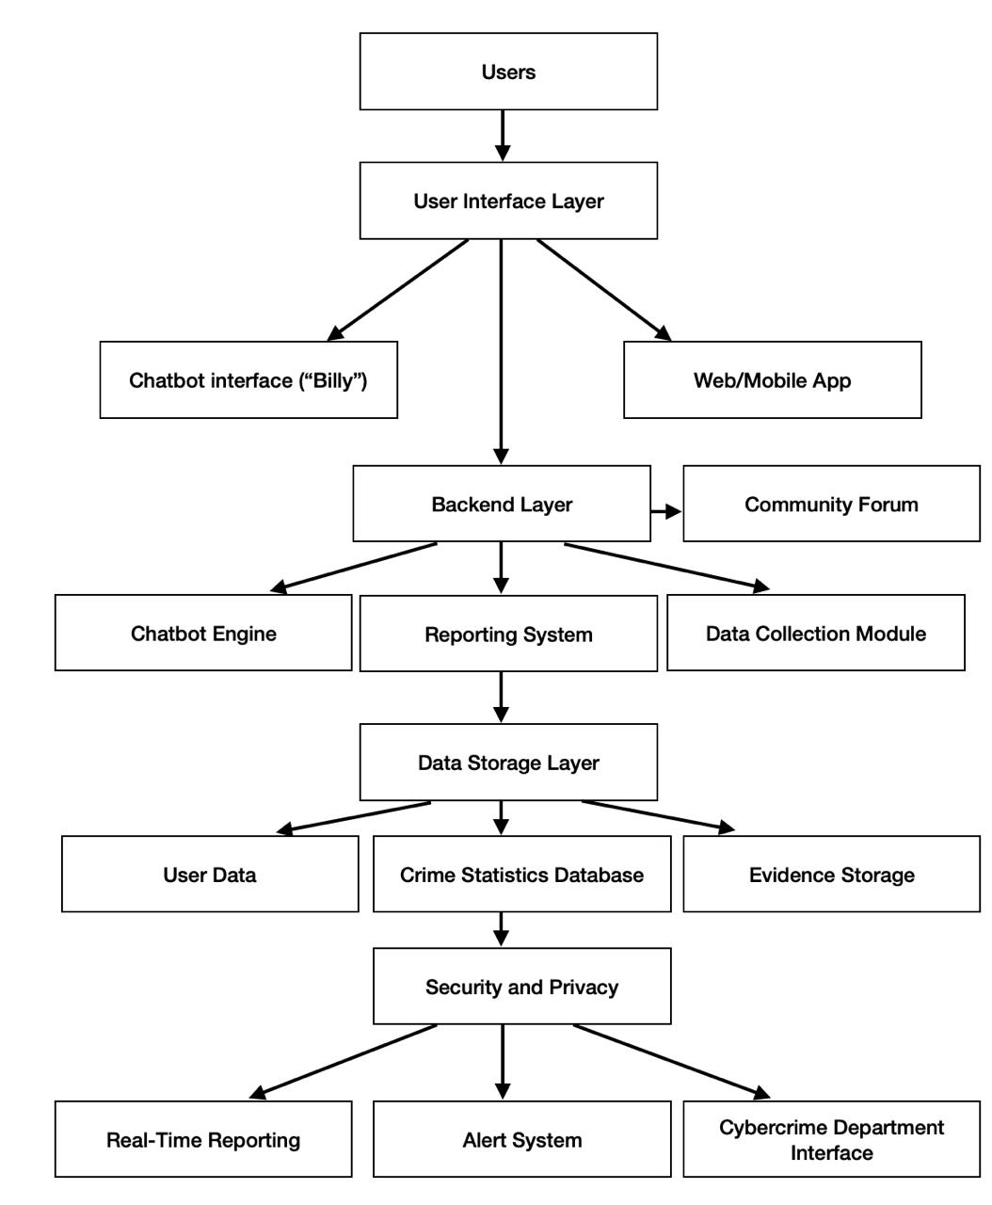
System Design and Implementation

Slide 8
System Design & Implementation
The system design of Billy Buddy outlines a structured approach to supporting victims of bullying. The User Interface Layer enables interaction through a chatbot named "Billy" and a web/mobile app, offering features like incident reporting and community discussions. These inputs are processed by the Backend Layer, which includes a chatbot engine, a reporting system, and a data collection module to manage and analyze user inputs effectively. The Data Storage Layer securely stores user data, crime statistics, and uploaded evidence in dedicated databases. A strong focus on Security and Privacy ensures encrypted data transfer, secure authentication, and compliance with user confidentiality. The system integrates external interfaces, enabling Real-Time Reporting of bullying incidents, alert systems for urgent notifications, and a Cybercrime Department Interface to forward complaints directly to authorities. This design provides a comprehensive solution, combining user engagement, data management, and proactive reporting to combat bullying effectively.

Slide 9
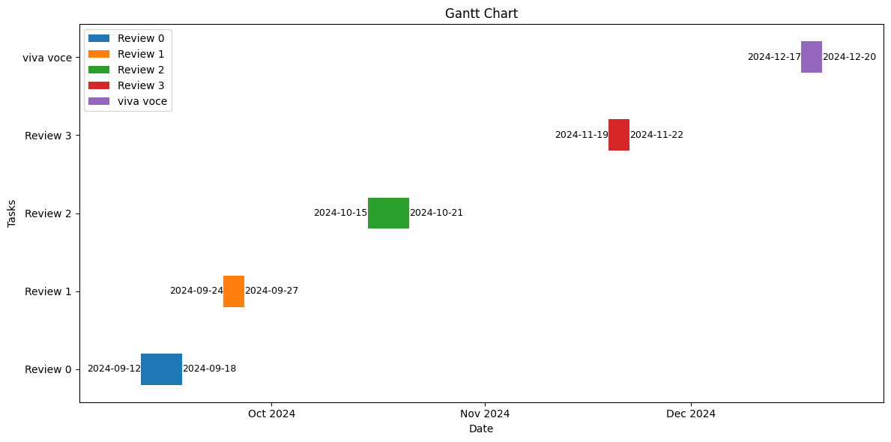
Timeline of Project

Slide 10
Outcomes
Increased Reporting of Cyberbullying Incidents: Victims will feel more comfortable reporting cyberbullying through the anonymous chatbot, leading to a higher number of cases being reported.
Timely Intervention: The real-time reporting system will enable faster responses from law enforcement, helping to address cyberbullying incidents more promptly.
Improved Victim Support: Victims will receive instant emotional support through the chatbot, reducing feelings of isolation, fear, and frustration.
Anonymity Assurance: Victims’ identities will remain protected throughout the reporting process, encouraging more individuals to come forward without fear of retaliation.
Increased Awareness of Cyberbullying: Educational resources and defense tactics on the platform will increase awareness about cyberbullying, its effects, and ways to combat it.
Formation of a Supportive Community: A virtual community of individuals who have experienced cyberbullying will provide emotional and practical support, helping new victims recover and learn coping strategies.
Data-Driven Law Enforcement: Cyber-crime statistics collected through the platform will help authorities focus on high-risk areas, enabling better resource allocation and targeted actions.
Reduction in Cyberbullying: With increased awareness, support, and law enforcement focus, there is potential for a gradual reduction in the overall number of cyberbullying cases.
Empowerment of Youth and Users: By providing access to self-help tools, defense tactics, and community support, the project will empower individuals to take proactive steps to protect themselves from cyberbullying.
Improved Mental Health Outcomes: Victims who receive timely support and feel part of a community are more likely to experience improved mental health, reducing the long-term psychological impact of cyberbullying.

Slide 11
Conclusion
"BILLY-BUDDY AGAINST CYBER BULLYING" is designed to address the rising issue of cyberbullying by providing immediate emotional support, ensuring victim anonymity, and reporting incidents to the cybercrime department. The innovative chatbot "Billy" empowers victims by offering a safe space to share their experiences, collect evidence, and connect with others who have faced similar challenges. By tracking cyber-crime trends and focusing on high-risk areas, this project contributes to a more proactive approach in tackling cyberbullying. Additionally, the platform’s educational resources and support community aim to equip individuals with tools to protect themselves and promote a culture of resilience. Ultimately, "Billy" serves as both a protective and empowering resource for victims of online harassment.

Slide 12
References (IEEE Paper format)
The role of perceived severity publicity anonymity type of cyberbullying and victim response.Retirved from https://www.sciencedirect.com/journal/computers-in-human-behavior
An investigation of the effectiveness and determinants of seeking support among adolescent victims of cyberbullying. Retrived from https://doi.org/10.1016/j.soscij.2018.09.011
“A Study of Cyberbullying Detection U sing Machine Learning Technique", 2020 Fourth International Conference on Computing Methodologies and Communi-cation (ICCMC),Retreived from https://ieeexplore.ieee.org/document/9076550
"Offensive text detection using temporal convolutional networks", Int. J. Adv. Sci. Technol, Retreived from https://www.researchgate.offensive text classification
"Cyberbullying detection solutions based on deep learning architectures", Multimedia Systems, Retrieved from https://link.springer.com/article/10.1007/s00530-020-00701-5
"Towards Automatic Detection of Inappropriate Content in Multi-dialectic Arabic Text", Advances in Computational Collective Intelligence. ICCCI 2022. Communications in Computer and Information Science(CCIS), Retrived from https://link.springer.com/chapter/10.1007/978-3-031-16210-7_7
"Multimodal cyberbullying detection using capsule network with dynamic routing and deep convolutional neural network", Multimedia Systems, Retreived from https://link.springer.com/article/10.1007/s00530-020-00747-5

Slide 13
Github Link
Github Link:
https://github.com/krithik202/Billy-Buddy-against-Cyber-Bullying

Slide 14
Publication Details
Journal Name : IJIRT
Journal Number : 63975
Paper Id :IJIRT171168
Status : published
Link : https://ijirt.org/Article?manuscript=171168

Slide 15


